Slide 1
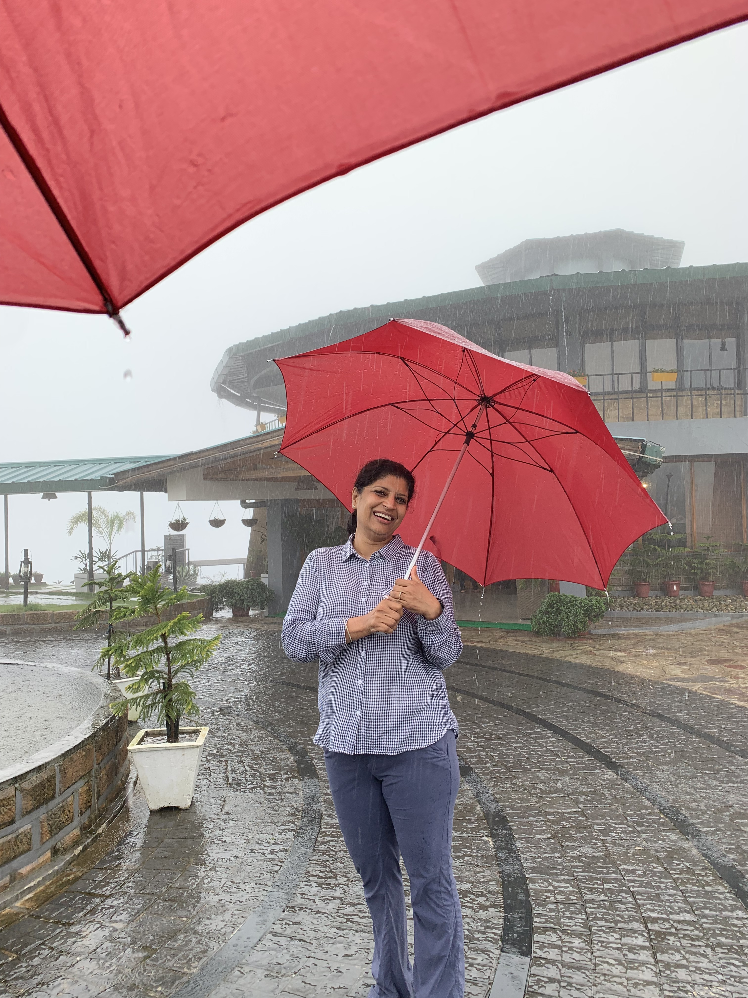
Welcome back!!
To the 2nd part of
Best of Best event.

Slide 2
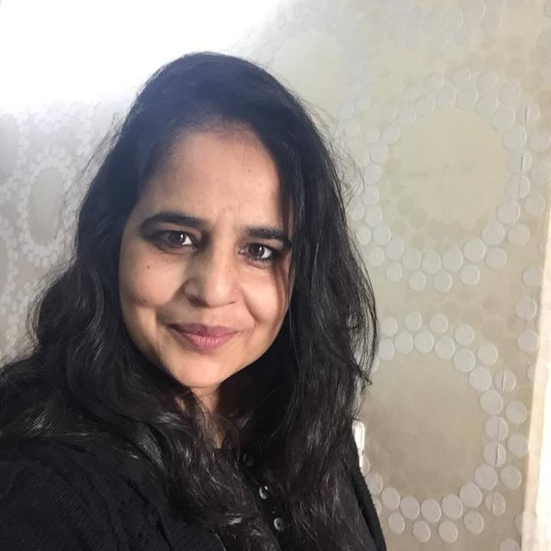
Dimple Sinha
Director

Slide 3
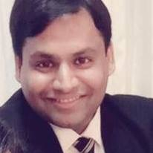
Mr. Jatin gupta
Senior area manager

Slide 4
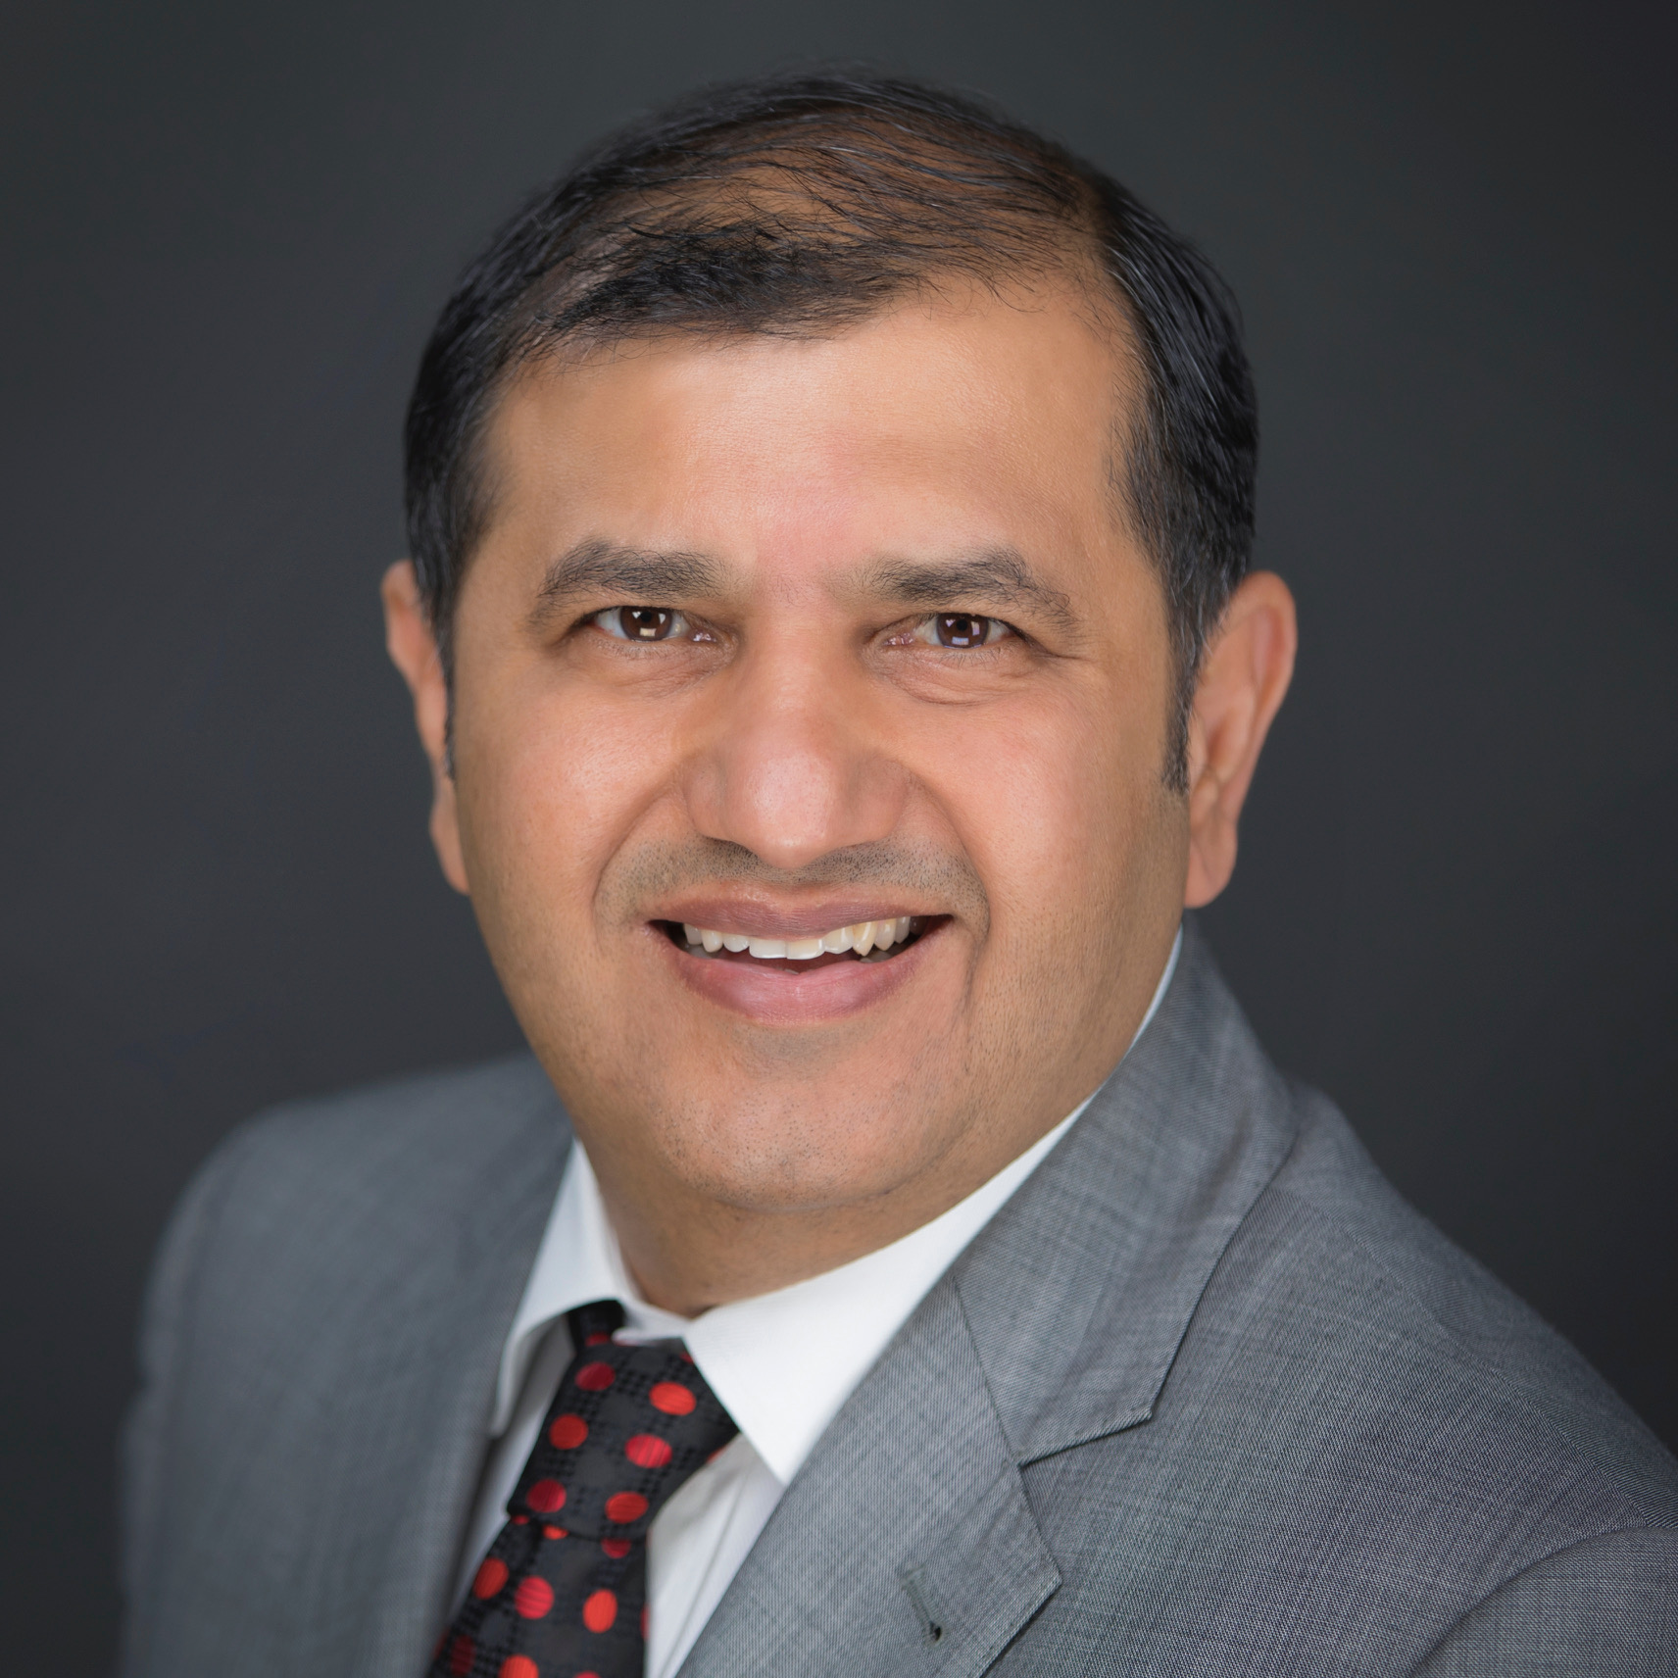
Mr. naveen anad
photo
Regional Marketing head : South Asia
Senior Director

Slide 5
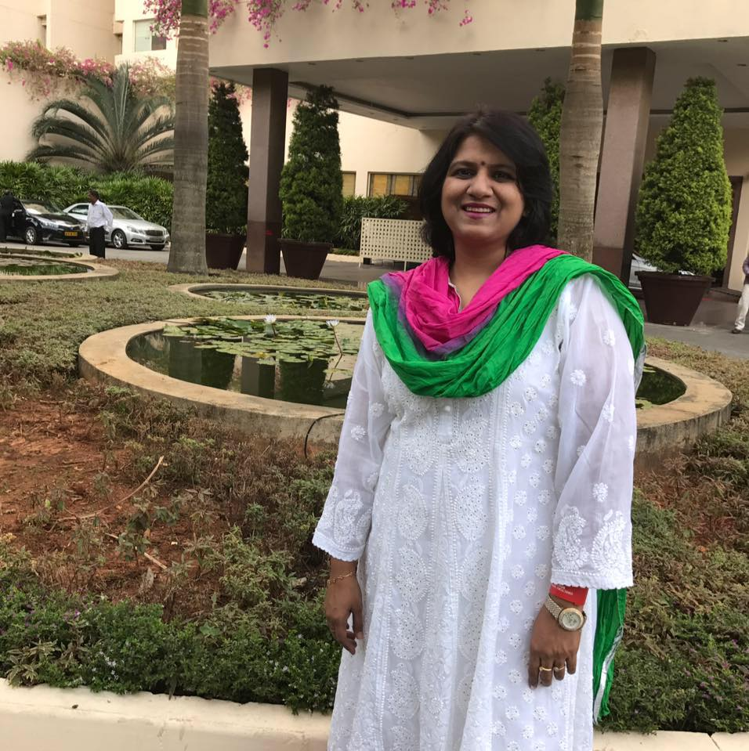
Pallavi Bharadwaj
photo

Slide 6
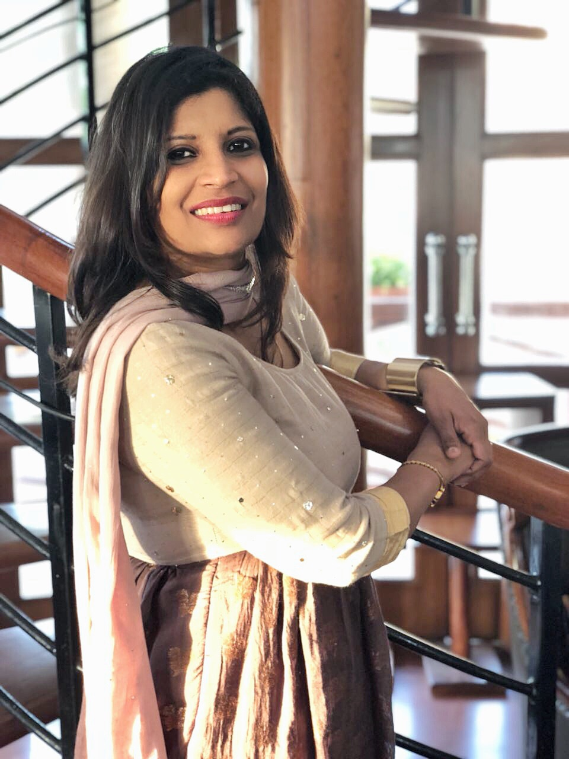
EXECUTIVE DIRECTOR ORIFLAME
NATIONAL RANKING 4
FOUNDER MEMBER : SPREADS HAPPINESS
SANGEETA AGGARWAL
SANGEETA AGGARWAL

Slide 7
Multi level marketing

Slide 8
According to business prediction mlm is going to be the biggest hit in 2050.

Slide 9
Network marketing is the real world business school for the people who actually want to learn the skills of an entrepreneur rather than skills of an employee.

Slide 10
There is a constant boost of positivity, growth and friendliness among the marketers. The recipe of success is shared with everyone.

Slide 11
In the market of recession with no job security, network is the best bet you can make to keep your future secure.

Slide 12
in the modernized world, where computers are taking over human work, networking is the only valuable skill that will remain in human hands.

Slide 13
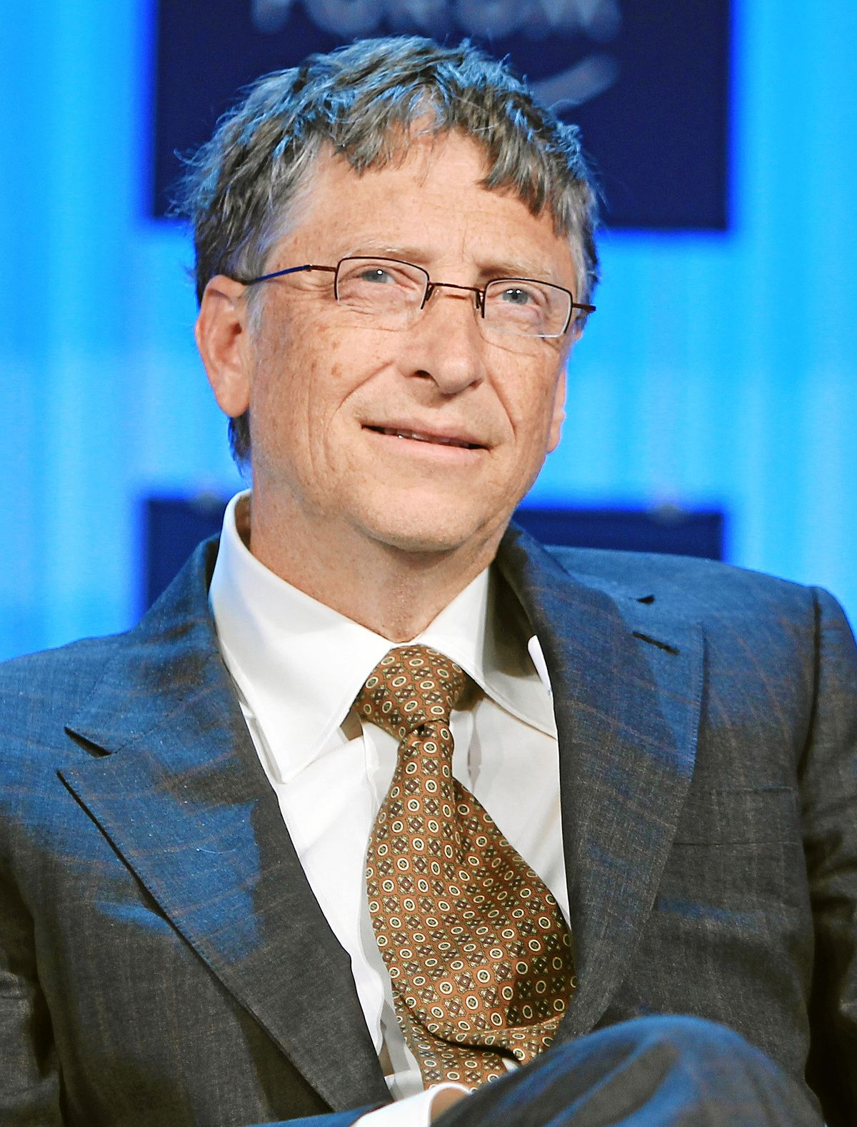
“if I would be given a chance to start all over again. I would choose network marketing” bill gates

Slide 14
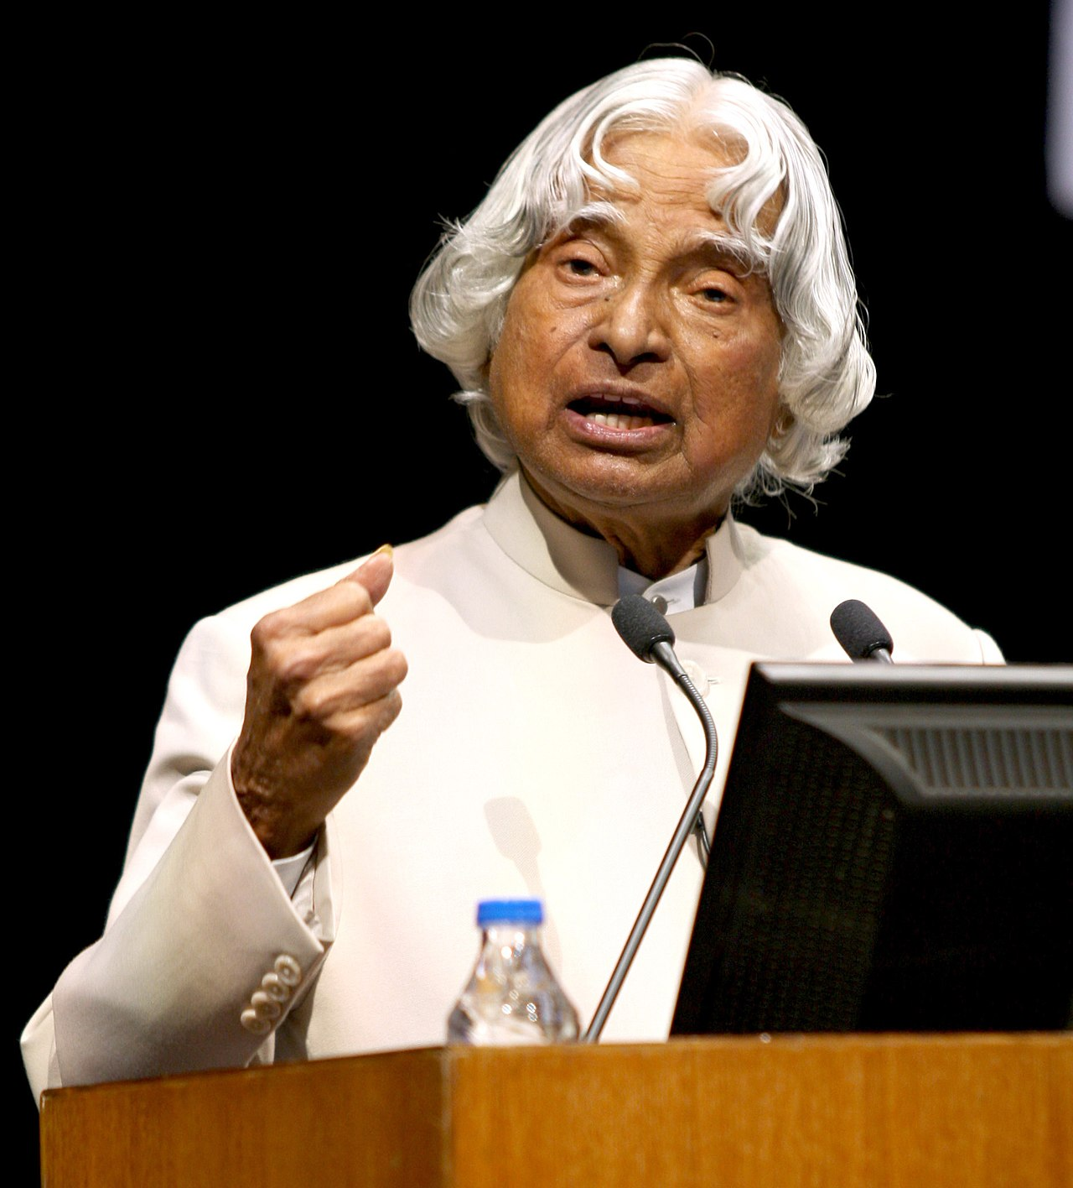
“Network marketing is the fastest growing business of 21st century which must be joined by every young man and woman globally otherwise you can never get the best of your youth age” dr. apj abdul kalam
https://www.youtube.com/watch?v=e8aLsQMiv5I

Slide 15
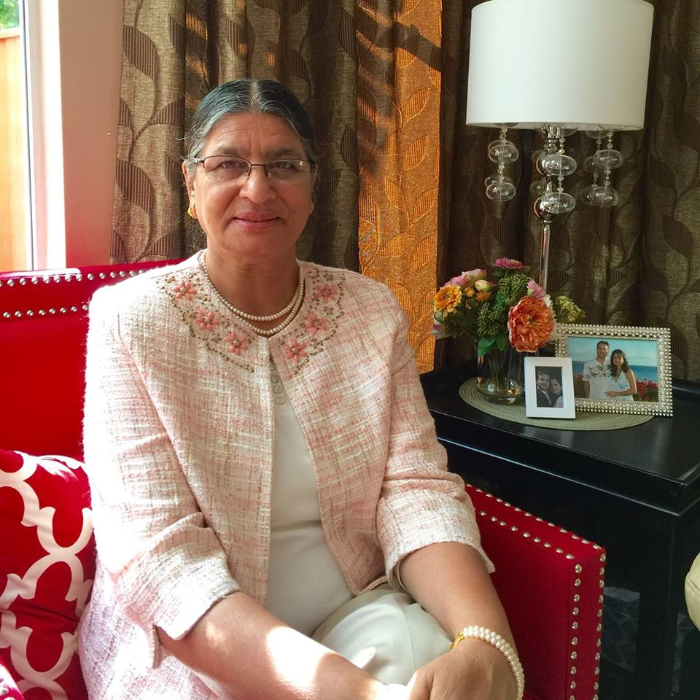
Terlochan KAUR DHALIWAL
Photo

Slide 16
Why oriflame in mlm?
1. Beauty by Sweden
2. Inviting Sponsor
3. Dream Program

Slide 17
Because we’re from SWEDEN we have a different view on beauty.
And for people

Slide 18





BEAUTY BY SWEDEN MEANS PRODUCTS
YOU CAN BELIEVE IN & STAND BY!
Notes:
We believe in responsible beauty creating safe products that are inspired by nature and powered by Swedish science..

Slide 19
Swedish people are one of a kind.
They hold a position of one of the top most trusted people in the entire world. Swedish people are known for their kind values and innovative minds. They are very thoughtful and concerned with their roles and responsibilities.

Slide 20




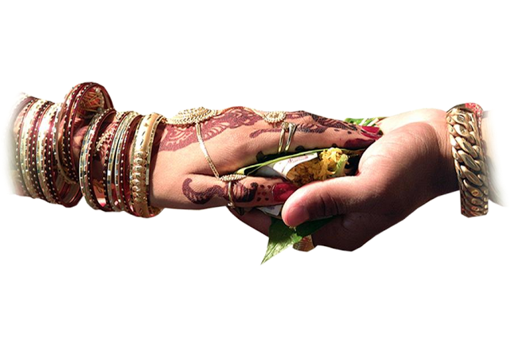
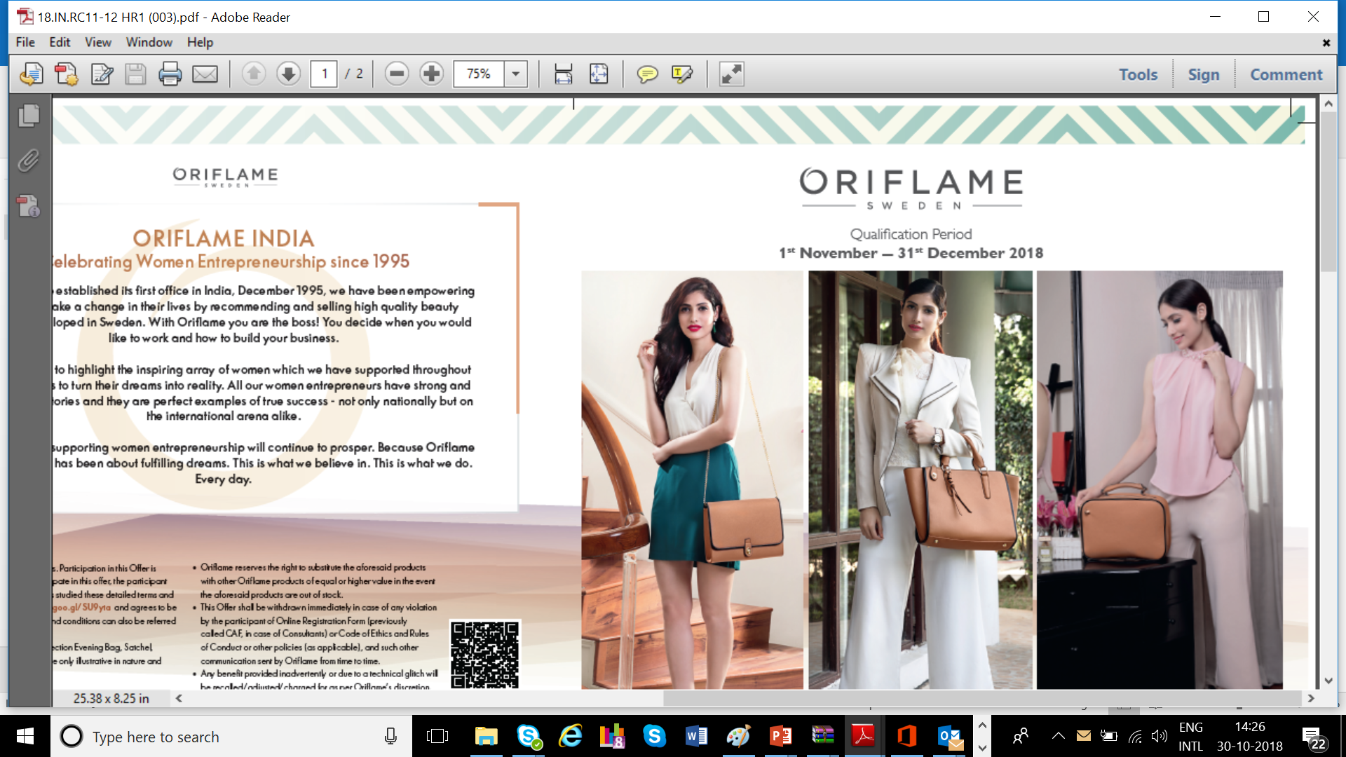
Oriflame Dream Program

Slide 21


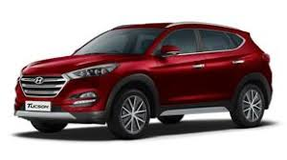


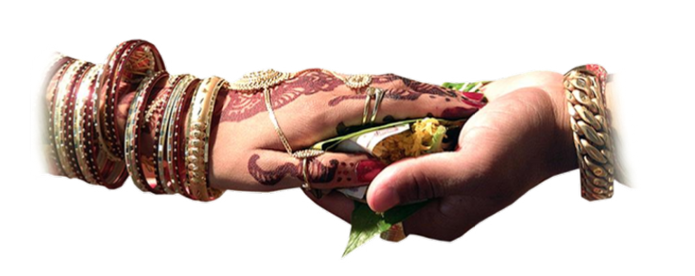



ORIFLAME DREAM PROGRAM –CAR,HOUSE,WEDDING & EDUCATION
Ensures higher income and long run stability
Easier to qualify for Conferences
Includes Car, House, Wedding and Education
Targets are easier to achieve and calculate
Exit anytime with 50% Reserve
No Lock-in!
Monthly Targets and Reserves

Slide 22
The Dream Program- Higher earning potential
Program comparison: Monthly earning potential overview
Title | Current LC | Current Car Program | The Dream Program | % Increase (Dream Program vs. Current Car Program)
Senior Manager | 4,000 | - | - | -
Director | 5,000 | - | - | -
Senior Director | 6,000 | - | - | -
Gold Director | 7,000 | 10,000 | 15,000 | 50%
Senior Gold Director | 10,000 | 15,000 | 20,000 | 33%
Sapphire Director | 14,000 | 21,000 | 25,000 | 19%
Diamond Team | 15,000 | 30,000 | 50,000 | 67%
Executive Team | 15,000 | 75,000 | 1,00,000 | 33%
President Team | 15,000 | - | 1,50,000 | 100%
Notes:
Oriflame at a competitive advantage with the dream program, with no competitor offering financial support for education and wedding

Slide 23
Annual Earning Potential
Stairs Stage Extra
Success
PRESIDENT
TEAM
18,00,000
Expansion
EXECUTIVE
TEAM
12,00,000
Emerging Growth
DIAMOND
TEAM
6,00,000
SAPPHIRE DIRECTOR
3,00,000
Seed
SENIOR GOLD DIRECTOR
2,40,000
GOLD
&
incomplete GOLD
1,80,000
Pre-seed

Slide 24


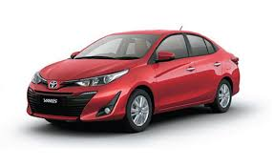
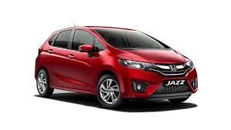

How much you can earn in 4 years!
EARNING POTENTIAL in the program
72 Lakh
48 Lakh
President Team
24 Lakh
Executive Team
12 Lakh
Diamond Team
9.6 Lakh
Sapphire Director
BMW 5 Series 520d
7.2 Lakh
Senior Gold Director
BMW X1 S
Gold Director
Hyundai Tucson 2WD MT
Toyota Yaris J MT
Honda Jazz V Petrol
Ford Aspire
Ambiente

Slide 25


Entry into Dream Program
1
2
3
CHOOSE
ELIGIBILITY
STEPS FOR ENTRY
Step 1
Step 2
LC Program
OR
The Dream Program
Gold Director Title
OR
At least 1 month maintain minimum 2 lines Structure in last 6 months
Apply
Sign Agreement

Slide 26
What are the targets ?

Slide 27
Target and Pay-out %
<1%
=1% <5%
=5% <10%
>= 10%
Target %
Pay-out as per the title structure for the month. Minimum 2 breakaways to be maintain
0%
50%
70%
100%
Pay-out %

Slide 28

My timeline!
http://www.spreadshappiness.com/my-travels/

Slide 29
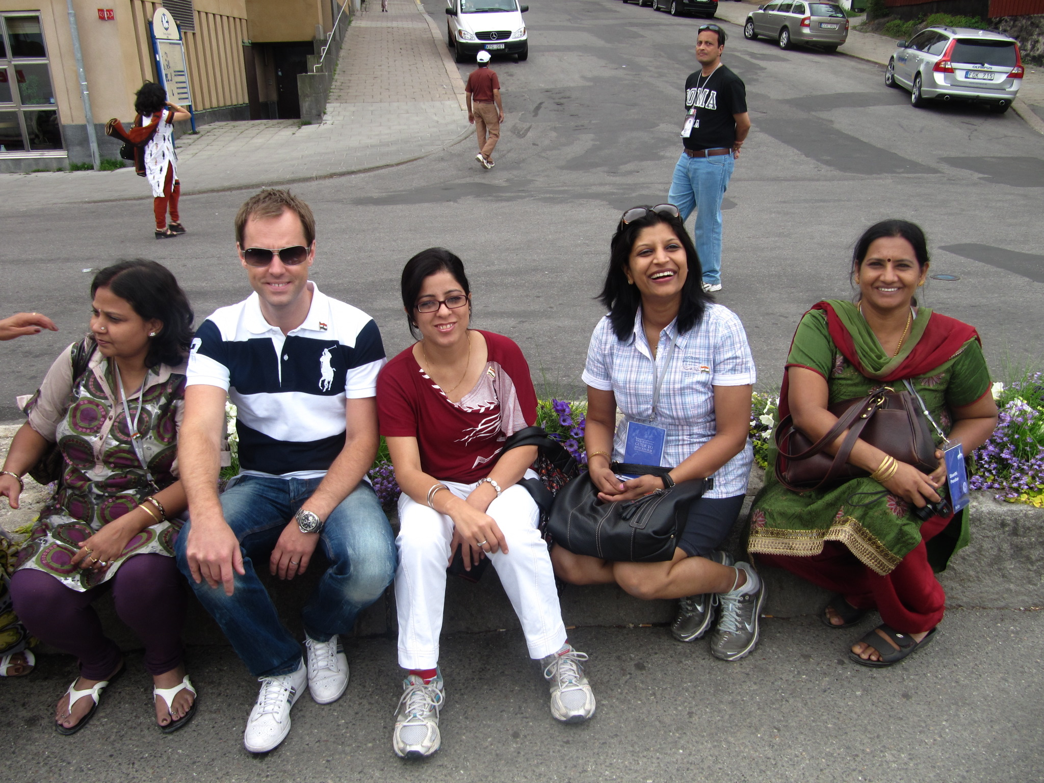
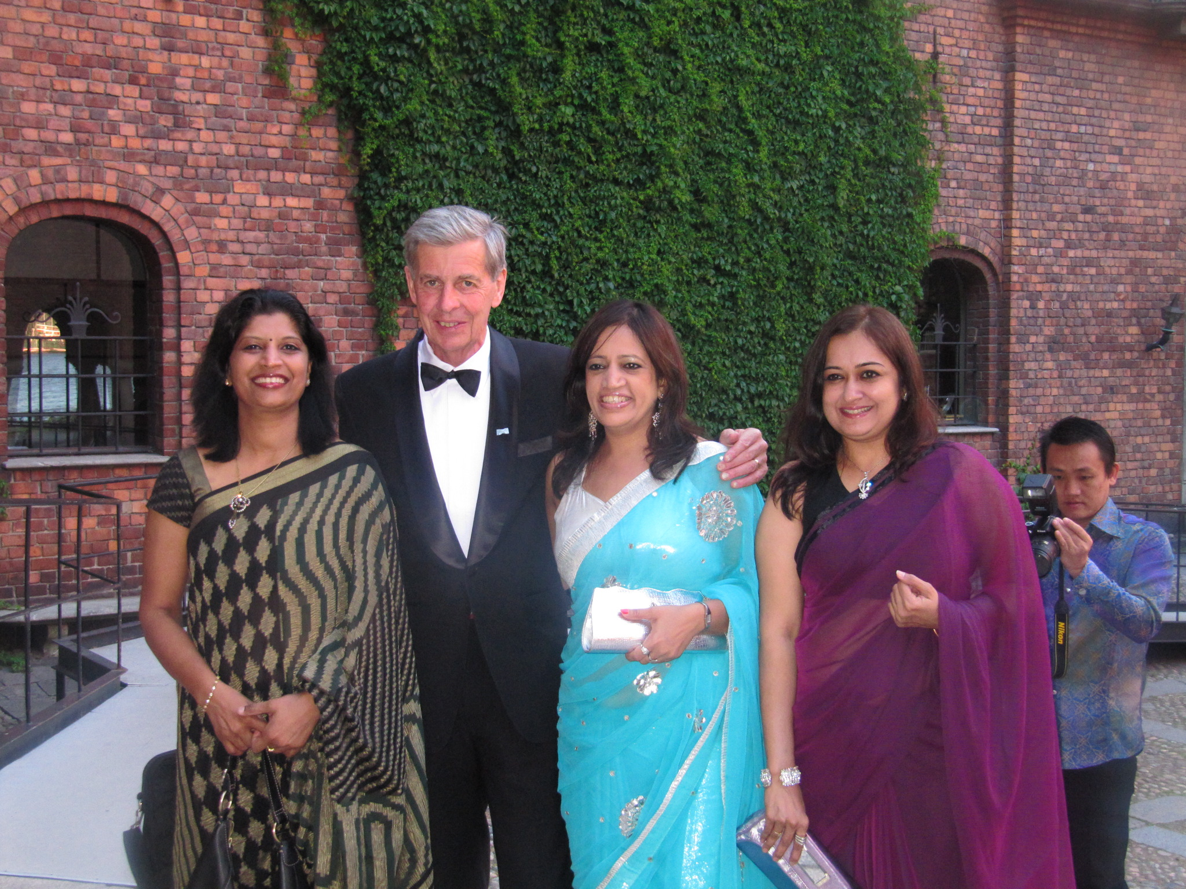
Stockholm for the 3rd time
2010
2010
2012
2019
2012

Slide 30

All throughout the year, no matter the weather, people in Stockholm are making the most of the closeness of nature to their city being HEALTHY AND ATIVE IS AN IMPORTANT PART OF LIFE IN SWEDEN WHAT WILL YOU GET UP TO WHEN YOU’RE HERE FOR THE GOLD CONFERENCE THIS SUMMER

Slide 31
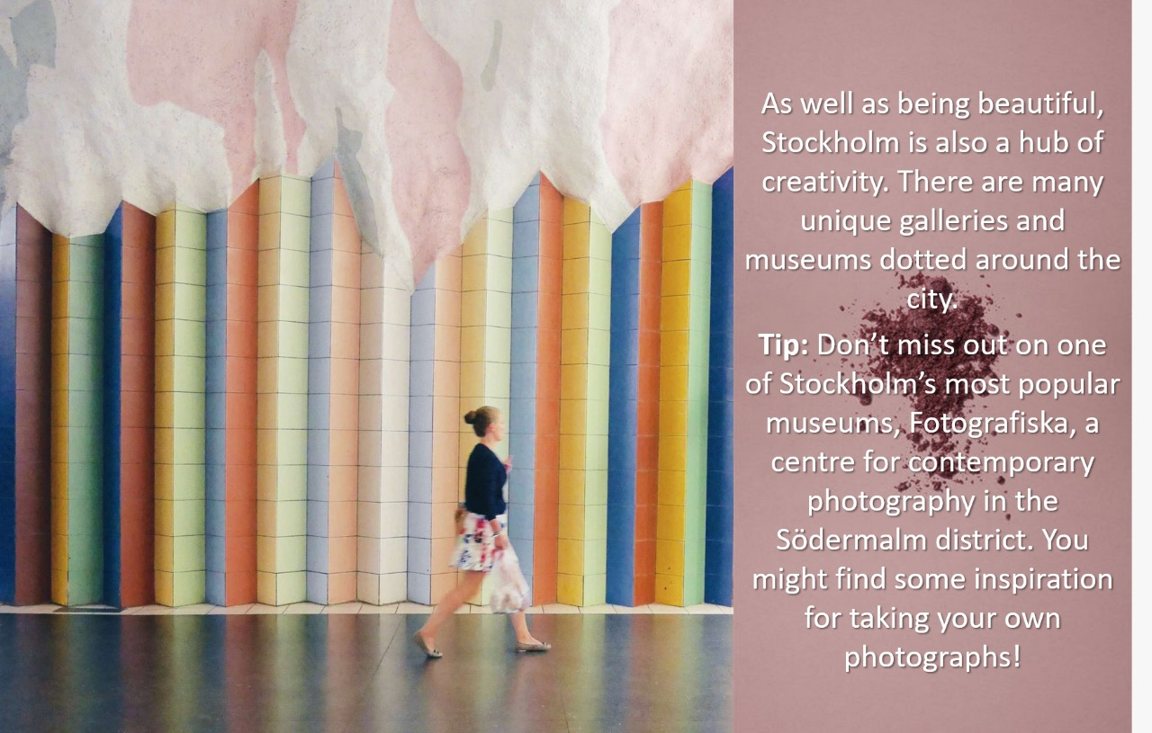
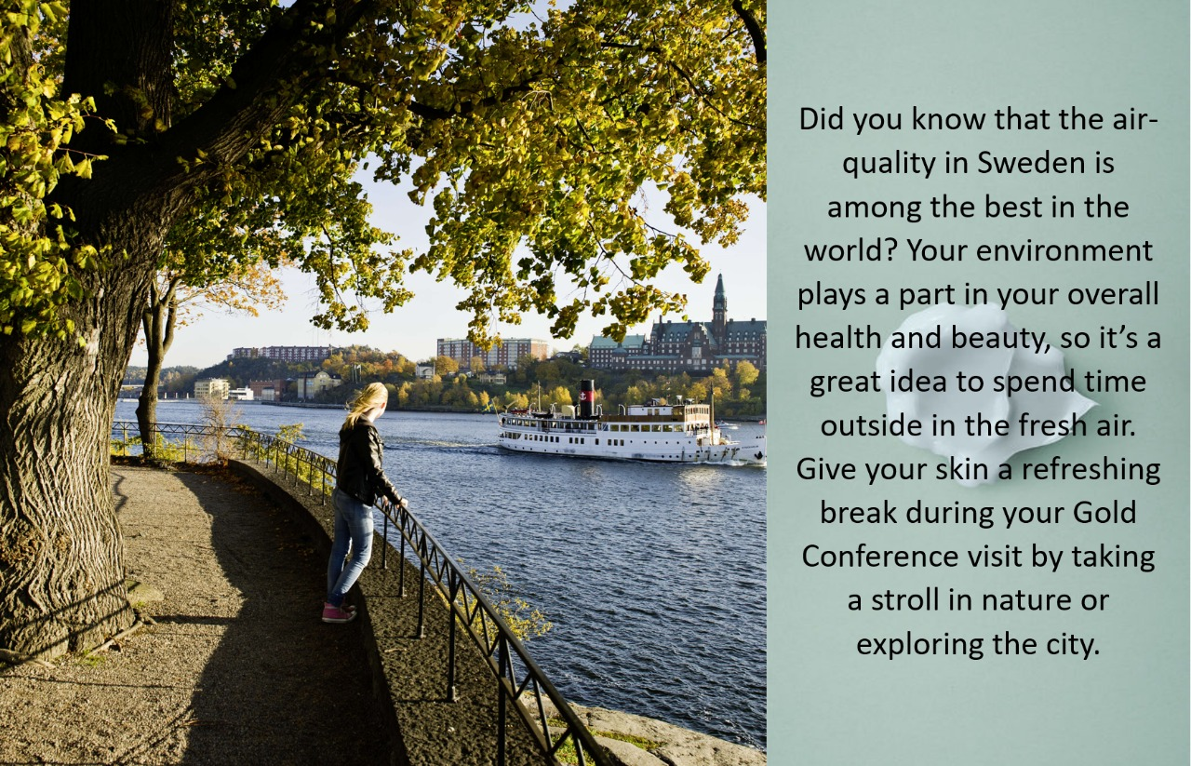
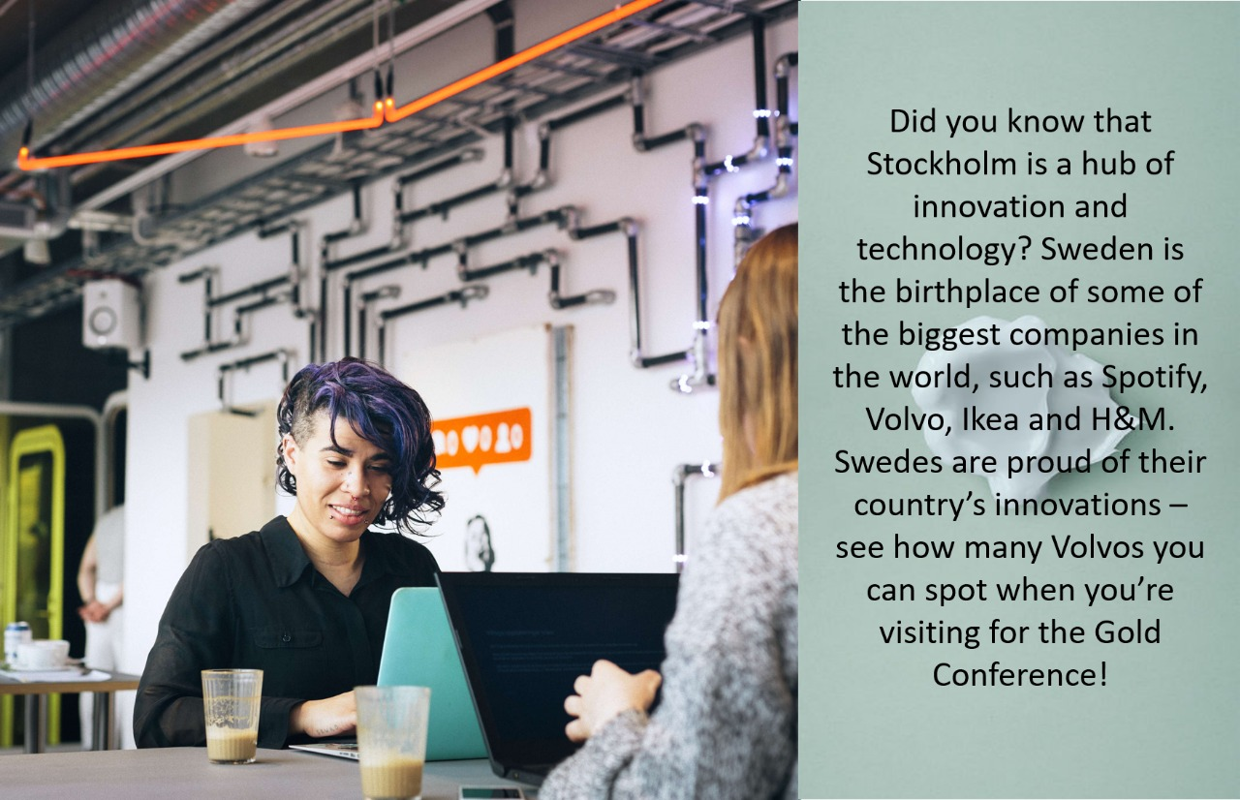
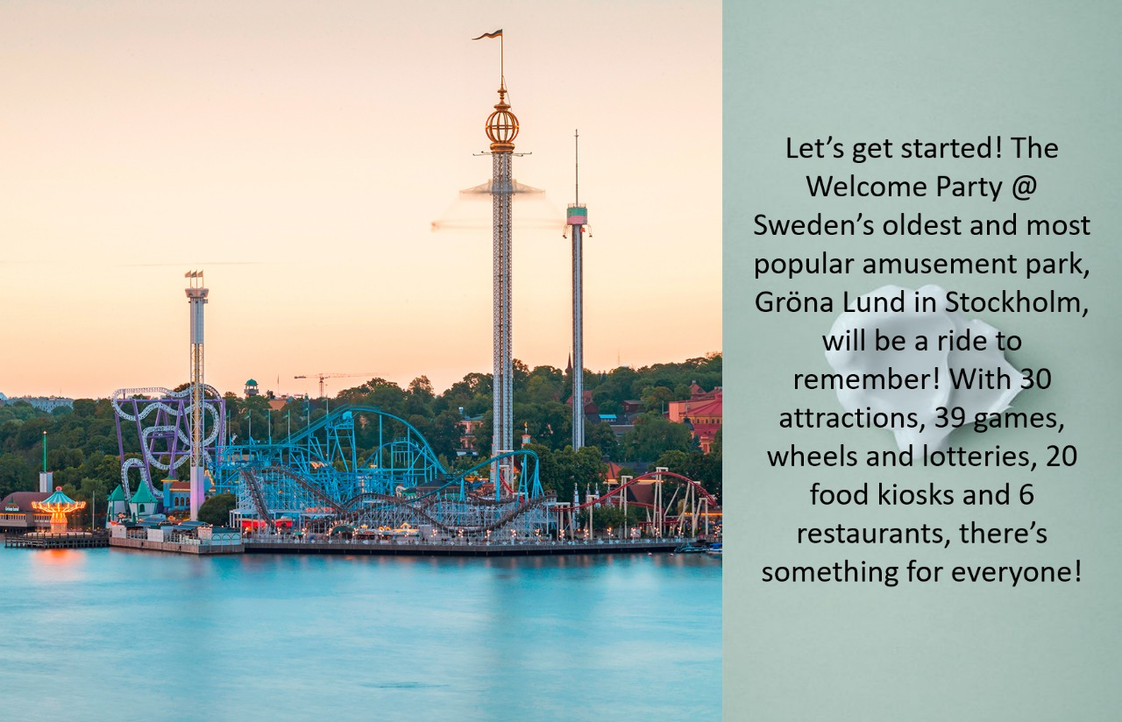

Slide 32
Thank you!!

