Slide 1
Social Media
Facebook page
Instagram page
What to post and how

Slide 2

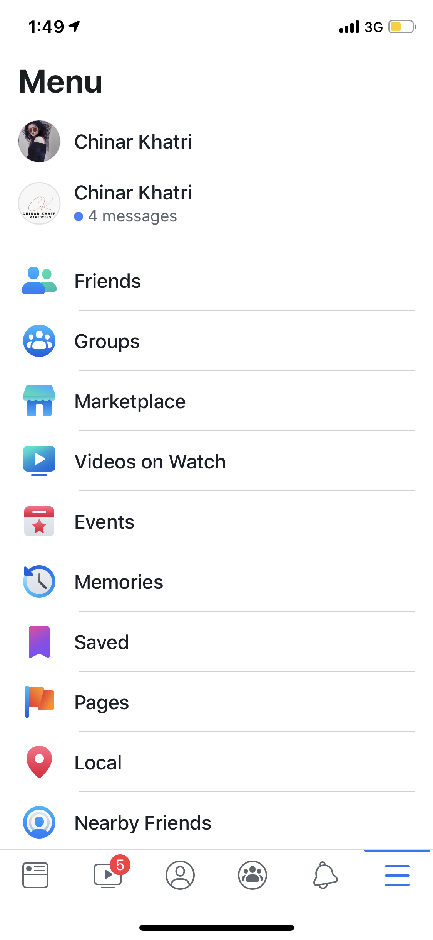
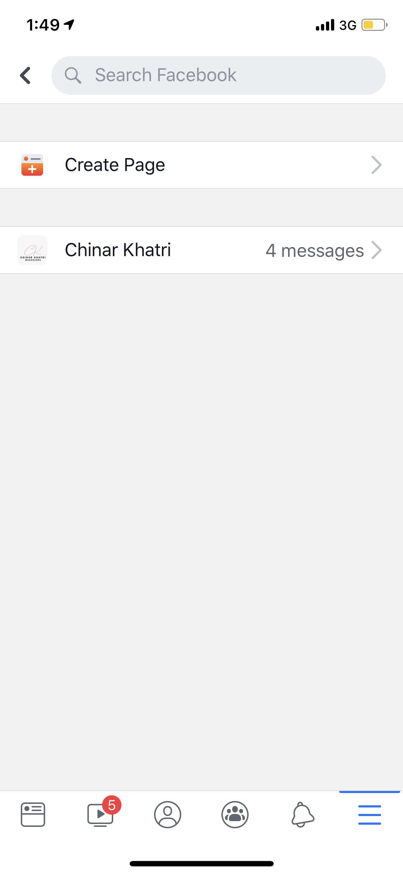

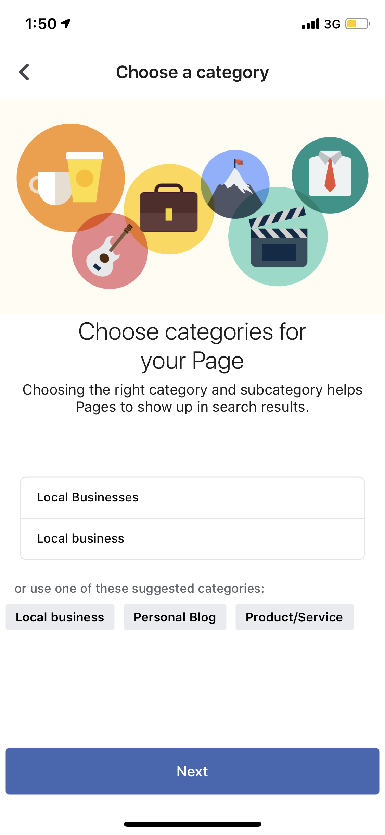
Facebook page

Slide 3
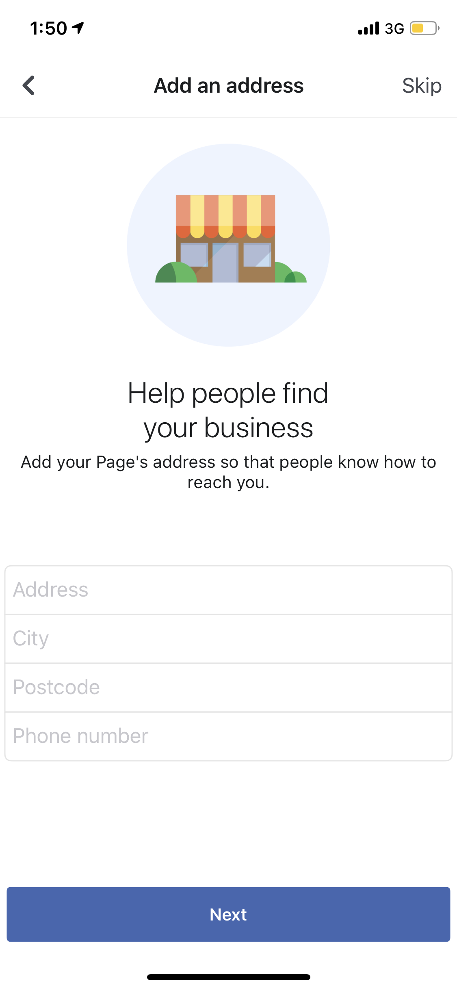

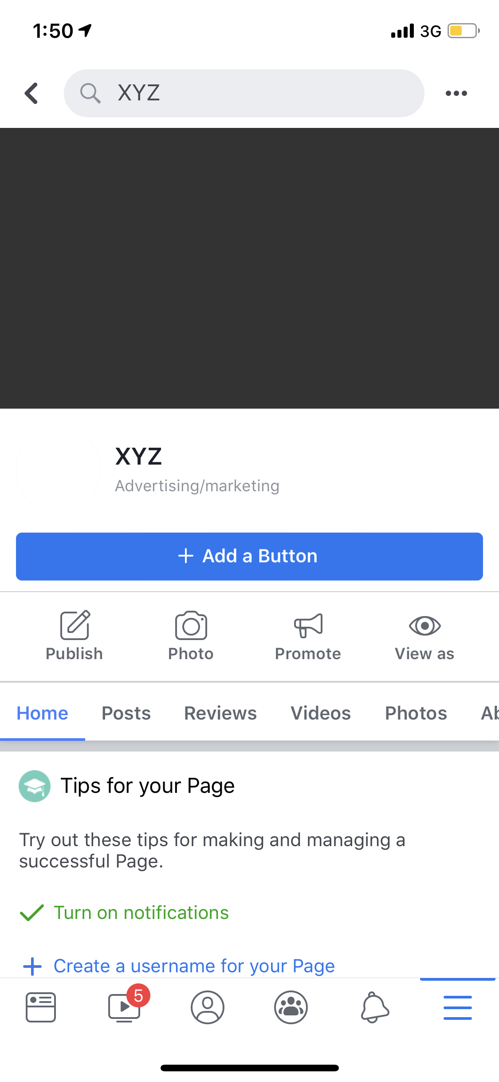
Facebook page

Slide 4
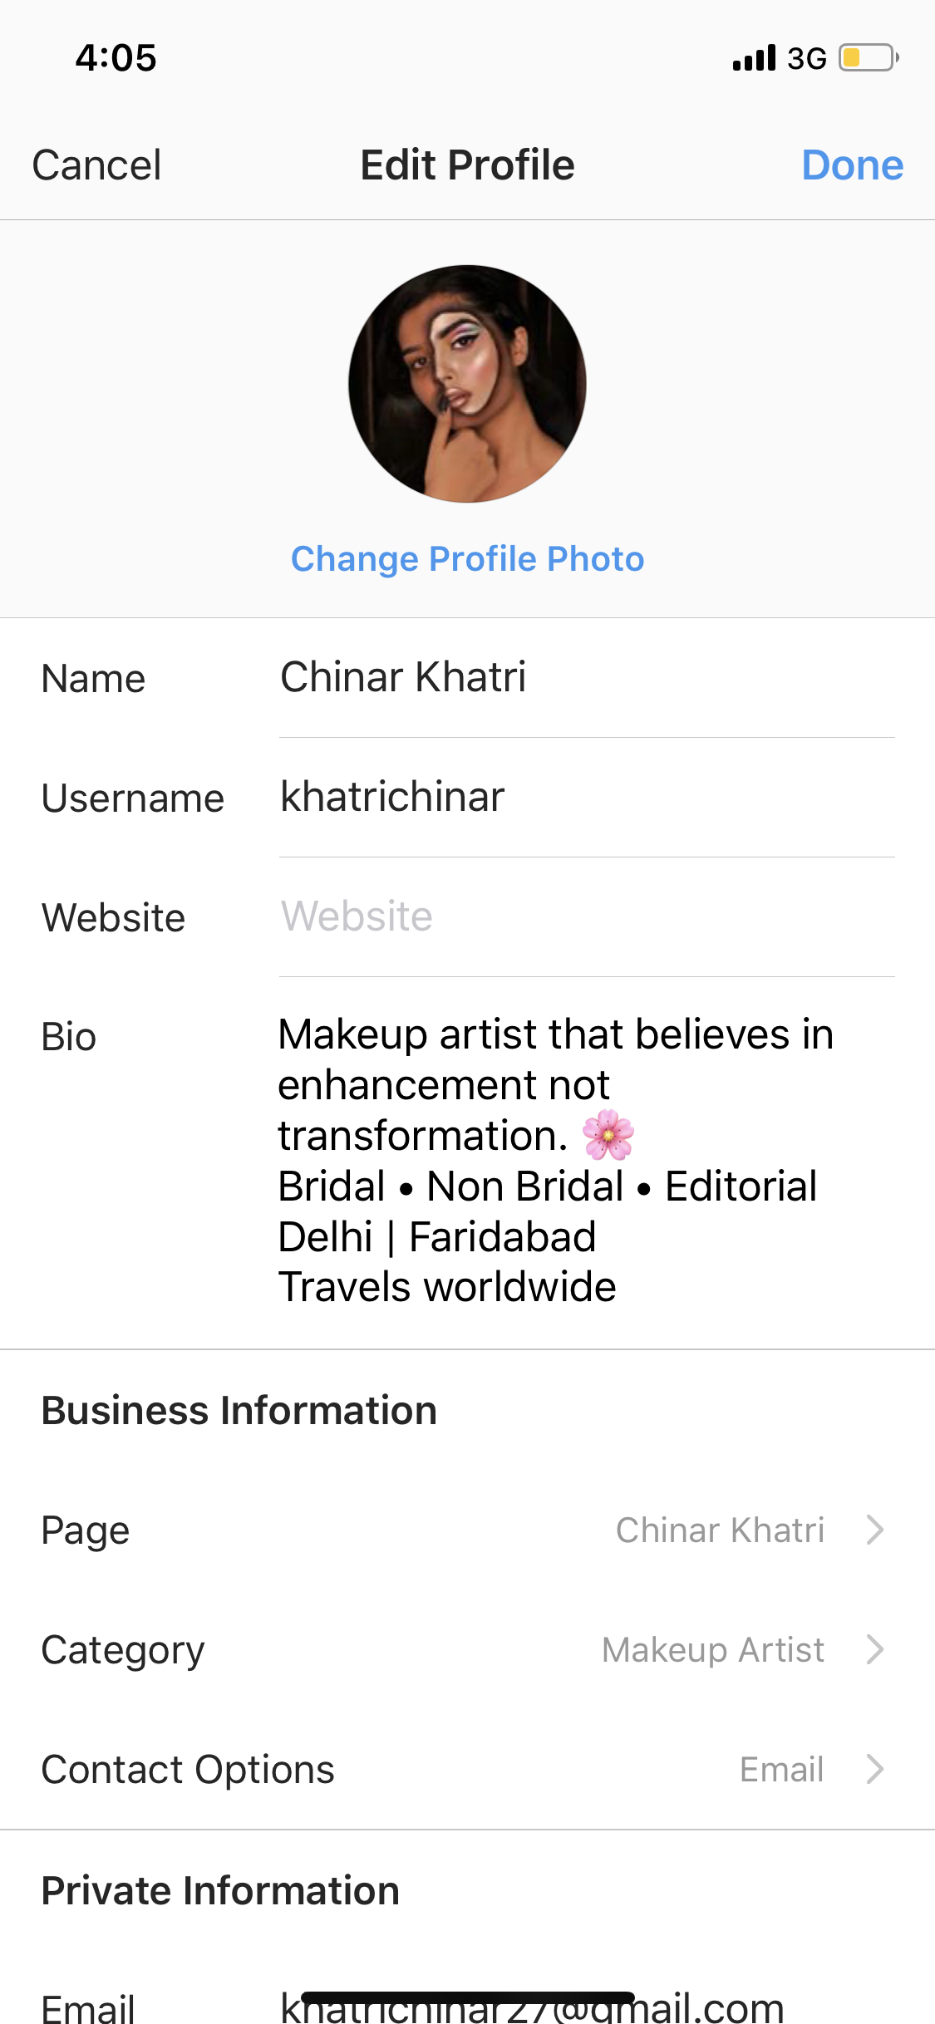
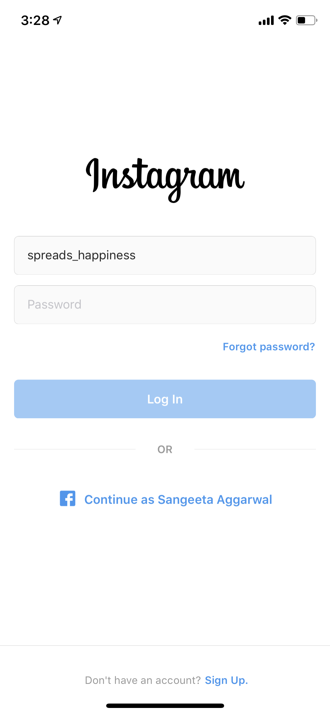
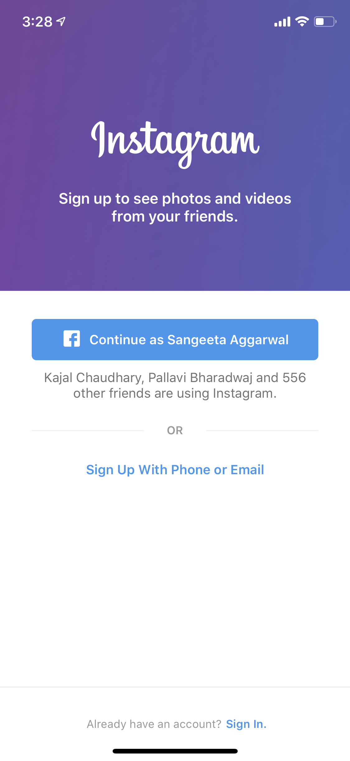
Instagram page

Slide 5

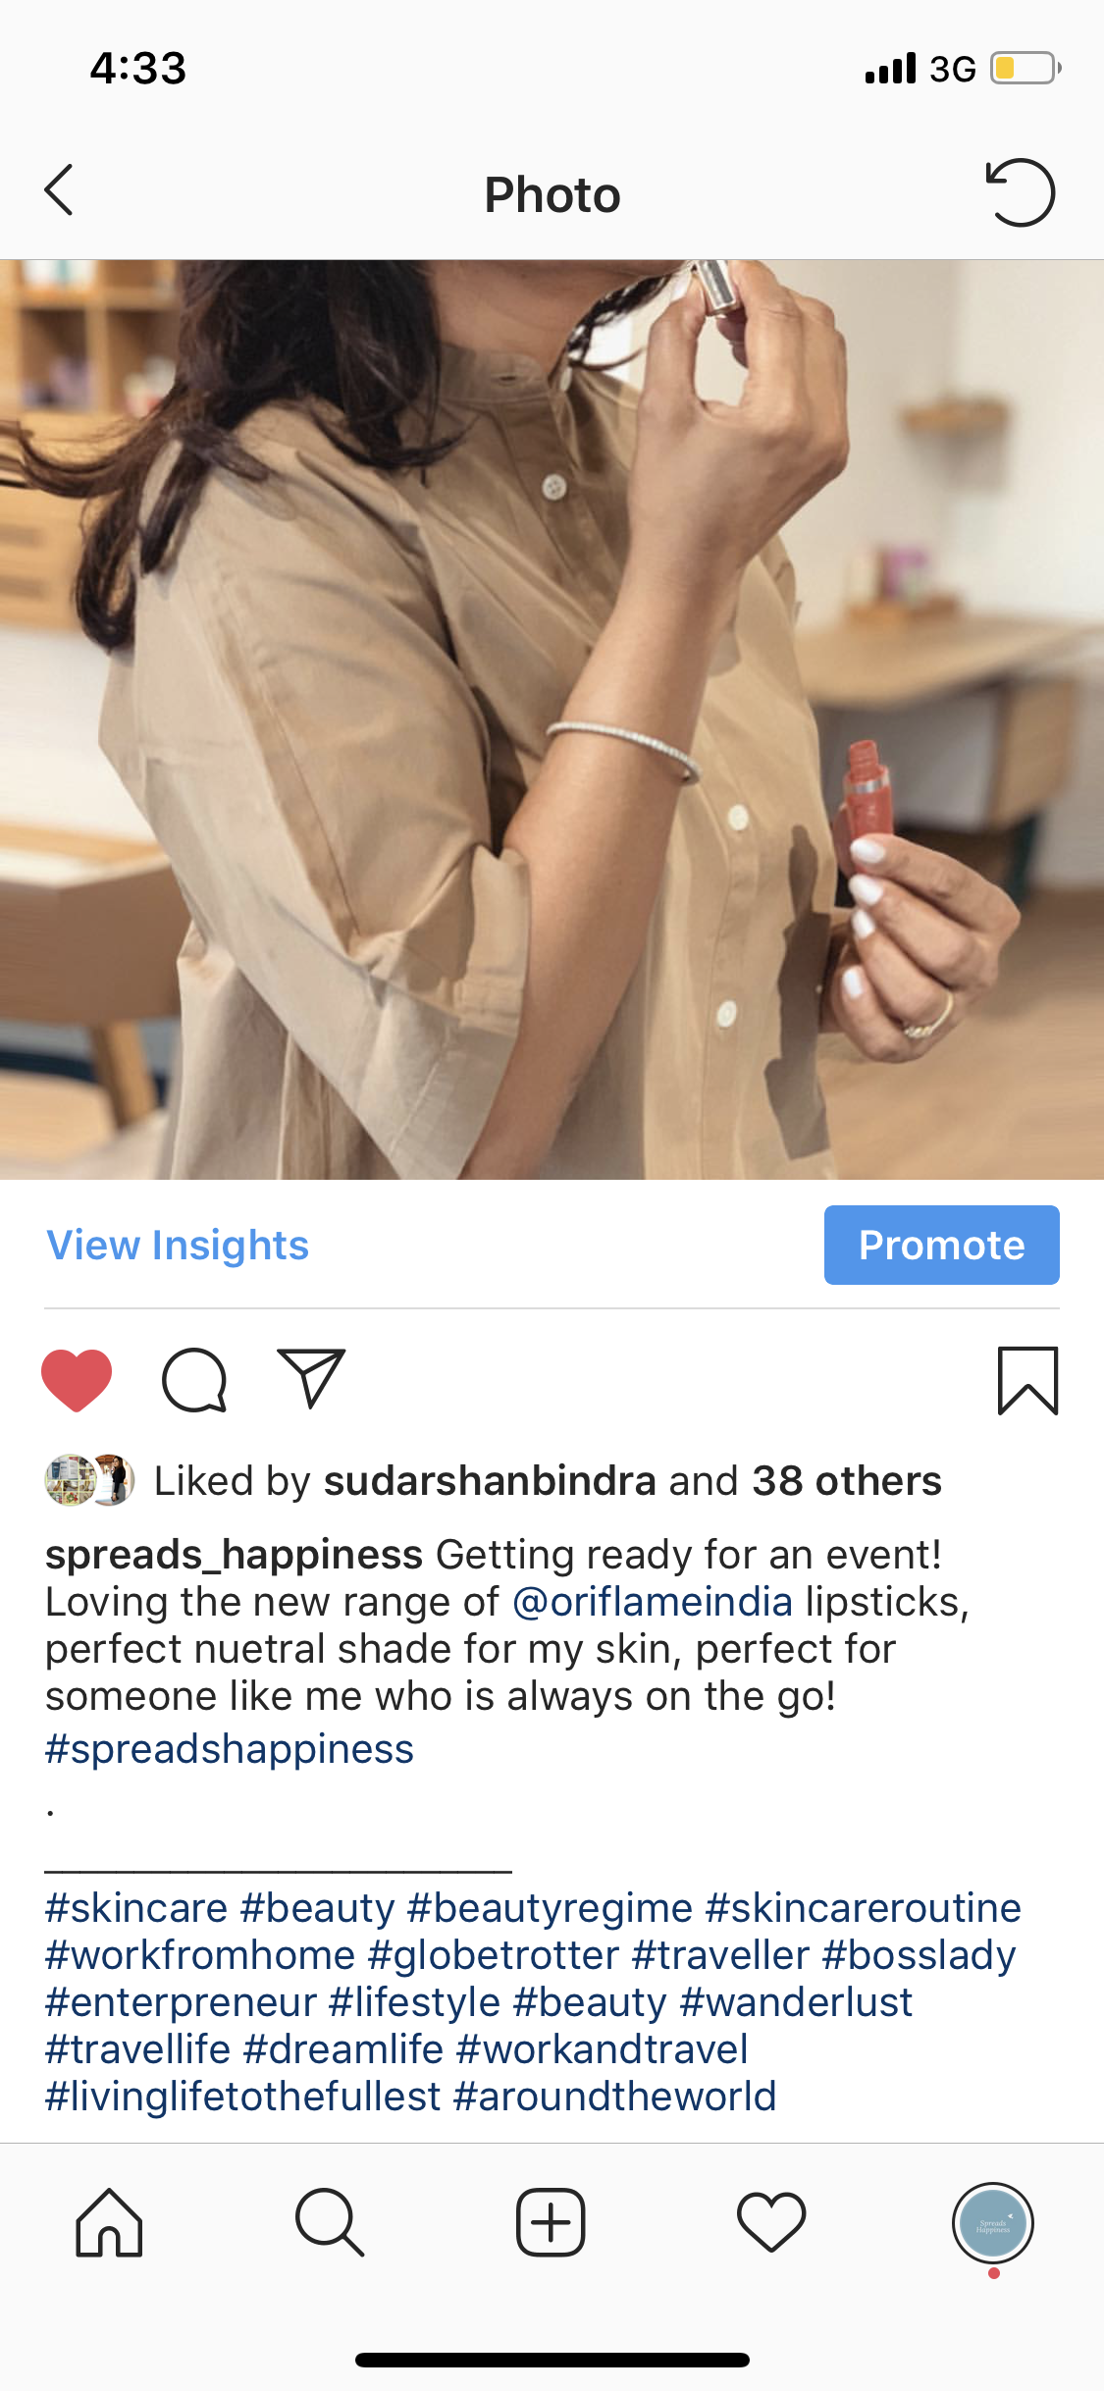
DO’s
Write or fill all the required fields, add a profile picture and cover picture.
Tell them what you do. For eg : entrepreneur, mommyprenuer, traveler, homemaker etc
Add all the pictures with suitable captions that generate curiosity and motivation.
Select your own unique hashtag that is not used by anyone add it to every caption.
Add generic hashtags also to reach wider audience.
20% directly related to oriflame : using any product. 80% yourself, your hobbies, attending events, shopping etc.
Post regularly, if you can’t do regular, atleast 3 times a week.
Add the same pictures to your whatsapp status as well, ask your friends to follow you on facebook and Instagram.

Slide 6
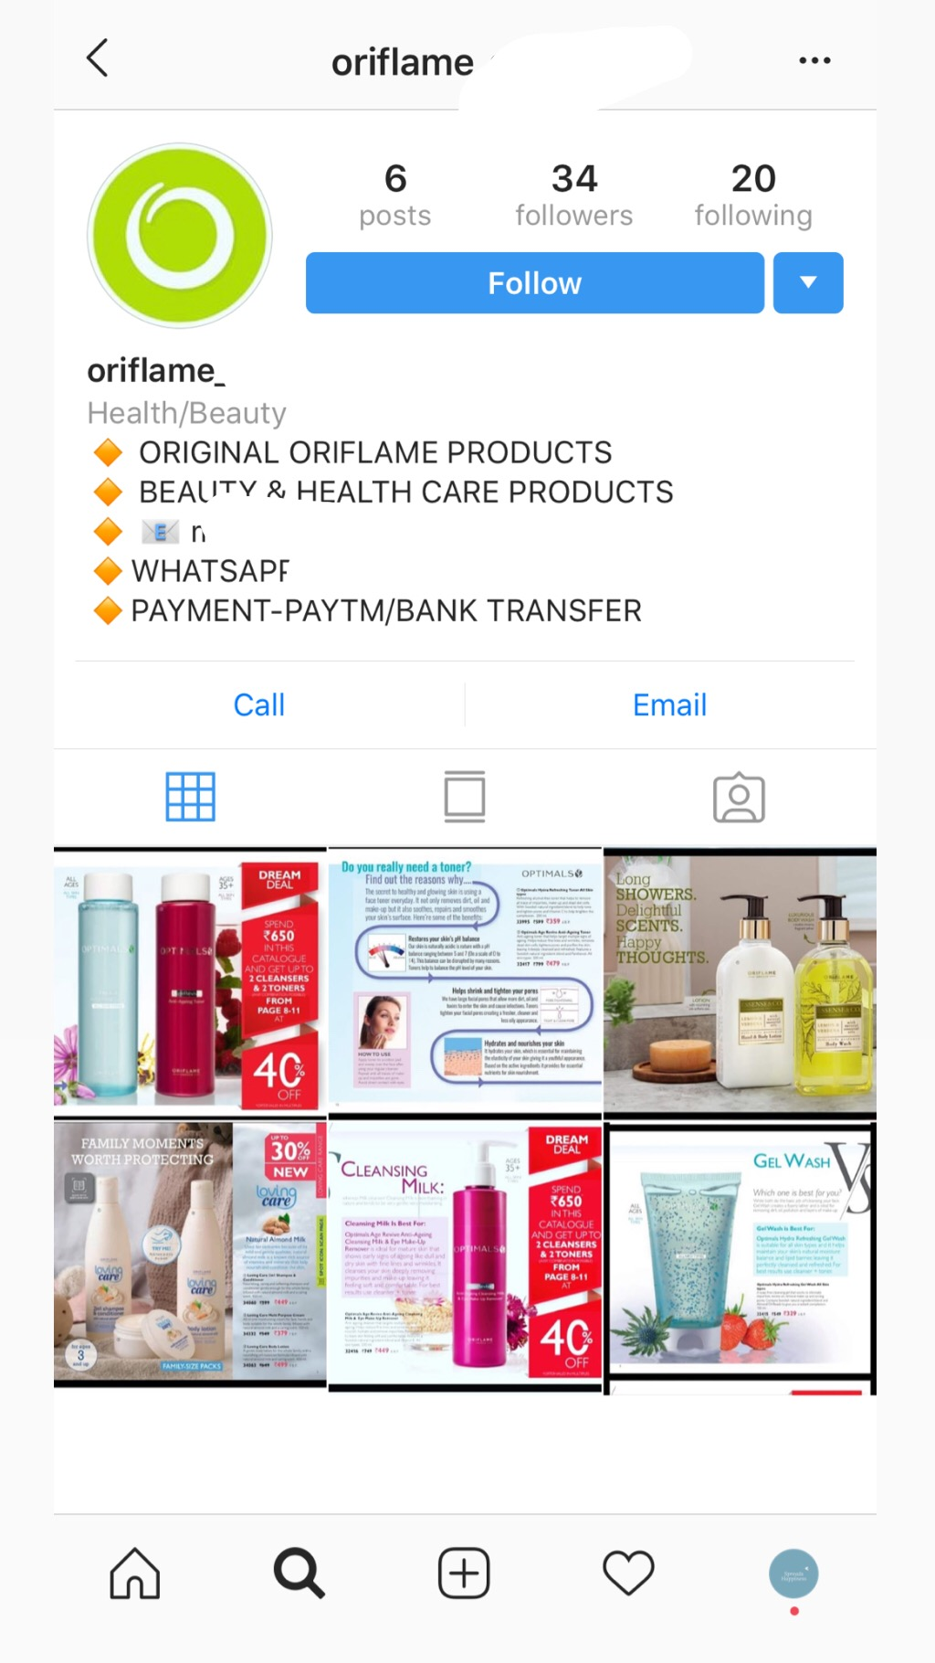
Don’ts
Donot mention ORIFLAME in your main information area or user name.
Donot copy paste oriflame’s catalogue in your pictures.
Donot show that you are trying to sell products.
Donot stop posting once you have started.

