Slide 1


DIGITAL WORKING
Notes:
Let me introduce the agenda for today’s course.

Slide 2

Agenda
DIGITAL SARPIO
DIGITAL SARPIO LEADERS
DIGITAL CHECKLIST
Notes:
Let me introduce the agenda for today’s course.

Slide 3

SUCCESS THROUGH DIGITAL SARPIO
SYSTEM
DUPLICATION
POWER LEG
Notes:
SARPIO is the SYSTEM
while online/offline are the METHODS & TOOLS!
-----------
NOW, We COULD divide this up
BY OFFLINE methods & tools & ONLINE methods & tools.
/Click to next slide/

Slide 4
DIGITAL SARPIO
Notes:
Before we go to discussion about what is SAPRIO digital
let’s learn from our LEADERS who use digital methods
and tools in their daily activities SUCCESSFULLY
I/d like to introduce you to 3 couples who will be very inspirational for you.
----------
First, going to Indonesia….

Slide 5
DIGITAL SARPIO
SARPIO/ Online System
These are NOT two different systems:
SARPIO is the system,
while offline/online are
methods and tools
Notes:
SARPIO is the SYSTEM
while online/offline are the METHODS & TOOLS!
-----------
NOW, We COULD divide this up
BY OFFLINE methods & tools & ONLINE methods & tools.
/Click to next slide/

Slide 6










Digital Leaders
Online SARPIO / Tools & Methods
OFFLINE
ONLINE
PROSPECTING,
RECRUITMENT
1-to-1 or group meeting
Name bank
Social media
prospecting
Webinars, messengers
LEADERSHIP DEVELOPMENT
Core team
Setting goals, follow up
Core team
Setting goals, follow up
KEEP NETWORK ACTIVE
Weekly group meetings
Class room trainings
Online trainings
Group chats
Notes:
If we LOOK at the SYSTEM used by LEADERS
who work ONLINE ,we can say all of them including our 3 couples
those methods we considered in the beginning
follow the SAME, KEY principles of SARPIO:
RECRUITMENT, LEADERSHIP DEVELOPMENT
& KEEP the NETWORK ACTIVE.
The MAIN difference
is that what tools and methods are used – online or offline in daily activities.
-------------
That’s WHY we STRESS that there aren’t TWO DIFFERENT systems! /CLICK TO NEXT SLIDE/

Slide 7
DIGITAL SARPIO LEADERS
Notes:
Before we go to discussion about what is SAPRIO digital
let’s learn from our LEADERS who use digital methods
and tools in their daily activities SUCCESSFULLY
I/d like to introduce you to 3 couples who will be very inspirational for you.
----------
First, going to Indonesia….

Slide 8


Nadia Meutia
TOP LEADER, INDONESIA
Co-founder of online system for leaders & consultants of her network.
Social media as the main tool for prospecting, recruitment & maintaining network activity.
Uses banners for promotions, selling & recognition.
Network website.
Clear roles & responsibilities for leaders at different levels.
Clear structure & demands for access to training.
Balance of offline & online activities.
Notes:
Introducing Nadia Meutia who is a TOP leader from Indonesia.
She joined Oriflame in 2006 and, from the VERY beginning,
has been using online tools for business development.
Actually, she and her partner, Dini Shanti,
were the FIRST leaders who started using online tools,
such as social media, the website, web training, blogs & forums for their network development.
They created a simple system that’s EASY duplicate for DEVELOPING leaders.
As a result – her network is one of the BIGGEST in Oriflame!
FOUR leaders from Nadia’s network
are members of the Global Leadership council!
Her MAIN prospecting tool is Facebook. She has more than 90k followers on her FB BUSINESS page!
She also focuses on her training system in her network, focusing primarily on training NEWCOMERS.
---------------
Now, moving on to….Indonesia again! Click.

Slide 9
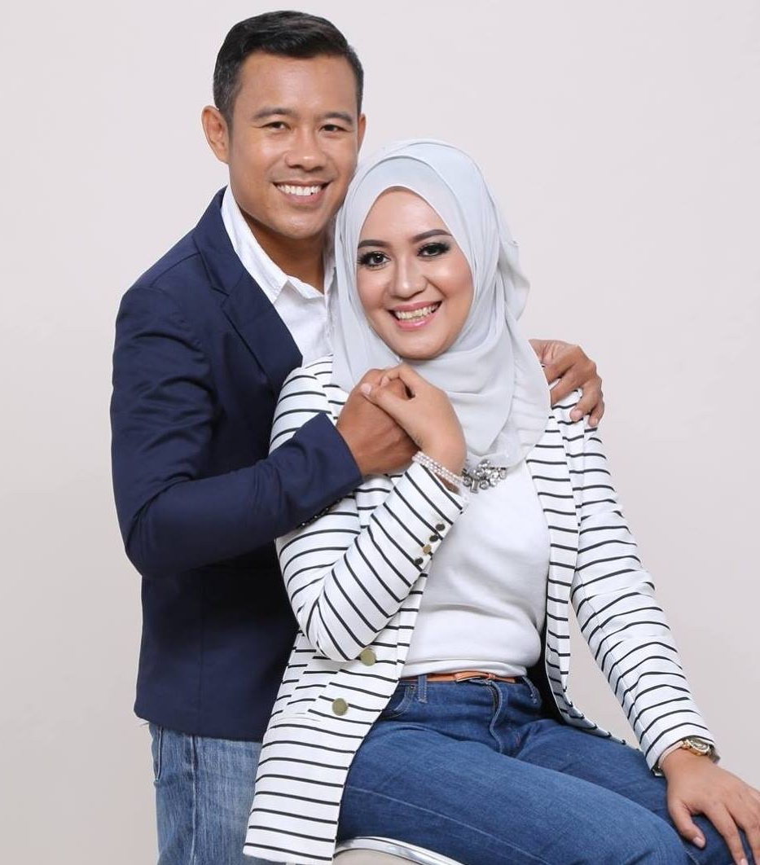
Yulia Riani & Andri Wibowo
TOP LEADERS, INDONESIA
Six-year journey from Consultant to Global Leadership Council members.
Use Social Media as a main tool for prospecting & communication via their personal profile & fan pages.
Online recognition & appreciation.
Story-telling, Emojis & high-quality pictures
Use WhatsApp for daily communication & training.
Create different chat groups for PG, Core Team & leaders at a certain level.
Balance of offline & online activities.
Notes:
Meet Yulia and Andri – from Nadia’s network,
who joined Oriflame in 2011.
FROM newcomers to becoming members of the Global TOP 15 took just SIX years!
Yulia is the former owner of a cake-decorator business, “makicakes”.
Andri is a former telecommunications engineer
====================================
Now, moving on to RUSSIA! Click

Slide 10
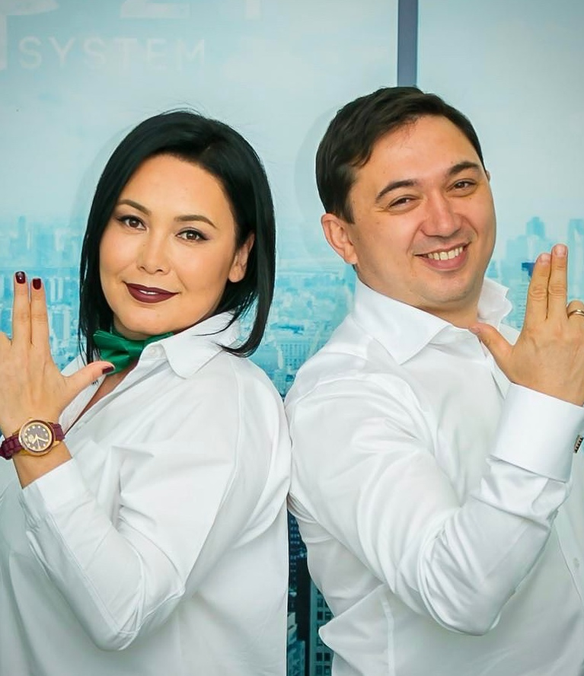
Albina & Irek Khafizovy
TOP LEADERS, RUSSIA
19 years with Oriflame.
Working online since 2016.
Prospect in social media (mostly Instagram).
Recruitment website, webinars for recruitment.
Use Messenger for keeping network active.
Segment communication in Messenger groups.
Strong training system on team website, segmented by consultant levels & activity.
EVERY quarter – major, motivational offline network meeting.
Notes:
Meet TOP leaders,
Khavisovy Albina & Irek, from Russia.
They joined Oriflame 19 years ago & achieved the position
of GOLD Executive Director as pure offline leaders.
But in 2014 they dropped from 15 to 8 split-out groups for in the first line.
In 2015, AFTER attending the Gold conference
where they saw MANY new leaders working online,
they took a decision to IMPLEMENT ONLINE methods
in their working system.
Together, with their leaders, they created the system,
launching it in December, 2015.
So, what can we LEARN from these leaders?
It’s important to STRESS that the KEY principles
of their working system have ALWAYS been the SAME: ‘Recruitment, Leadership Development & Keep the Network Active.
BUT, they’ve ALSO turned their efforts towards ONLINE methods & tools, such as social media, Messenger & their website.
From 2016-2017, they doubled their network sales growth with more than 200 consultants achieving different leader levels.
They’ve restored their HIGHEST title – as GOLD Executive Directors & are now on their way to EVEN higher levels!
Talk about MOTIVATIONAL & INSPIRATIONAL!
-------------
WHAT LESSONS CAN WE LEARN FROM THEM?
WHAT SPECIFICALLY CAN WETAKE AWAY WITH US TODAY? /Click to next slide/

Slide 11

They COMBINE ONLINE and OFFLINE methods and tools
They FOLLOW the three SARPIO KEY PRINCIPLES – Recruitment, Developing Leadership & Keep The Network Active
SOCIAL MEDIA is a
main source to meet new people
Focus on DAILY online TRAININGS
Notes:
VERY SPECIFICALLY,
(read the 4 points out loud above, slowly)
------------
But here’s a question; What do you see as the DIFFERENCE
between Sarpio and DIGITAL Sarpio? /CLICK: answer on next slide//

Slide 12
DIGITAL SARPIO CHECKLIST
Notes:
Before we go to discussion about what is SAPRIO digital
let’s learn from our LEADERS who use digital methods
and tools in their daily activities SUCCESSFULLY
I/d like to introduce you to 3 couples who will be very inspirational for you.
----------
First, going to Indonesia….

Slide 13
2
Target Audience
5
Content Calendar
8
Optimize Landing Page
11
Training Calendar
1
4
7
10
Personal Brand
Organize Profile
Template to Recruit
Core Team
13
Working Calendar
3
Social Media Platform
6
Budget for Adverts
9
Personal
OOM
12
Segment Communication
Notes:
VERY SPECIFICALLY,
(read the 4 points out loud above, slowly)
------------
But here’s a question; What do you see as the DIFFERENCE
between Sarpio and DIGITAL Sarpio? /CLICK: answer on next slide//

